Slide 1
Python Workshop: Intermediate
Spring 2020

Slide 2
General Topics we’ll cover
Python Environments
Anaconda
Installing packages
ArcGIS API for Python
Querying data
Spatial Dataframes
pandas syntax
Editing data
Cleaning your code
Commenting
Documenting
Creating your own package
And more…

Slide 3
Python Environments
ArcGIS Pro comes with a default environment
Has arcpy installed
Cannot be changed/upgraded
Can be “cloned”
When to create a new environment?
Upgrading packages
Adding new packages

Slide 4
Anaconda Outside ArcGIS Pro
Free download
Comes with
Jupyter Notebooks
Spyder (IDE)
No arcpy

Slide 5

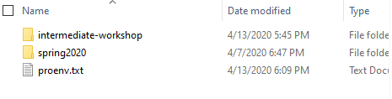
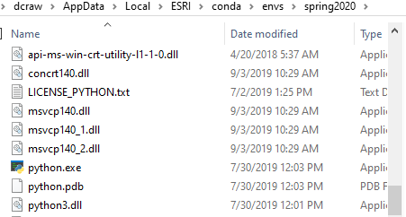
What Creating a New Environment Does
Makes a new unique installation of python
Allows you to modify the environment without harming your root environment

Slide 6
Extra Fun
Create your own environment in ArcGIS Pro

Slide 7
ArcGIS Online Basics

Slide 8
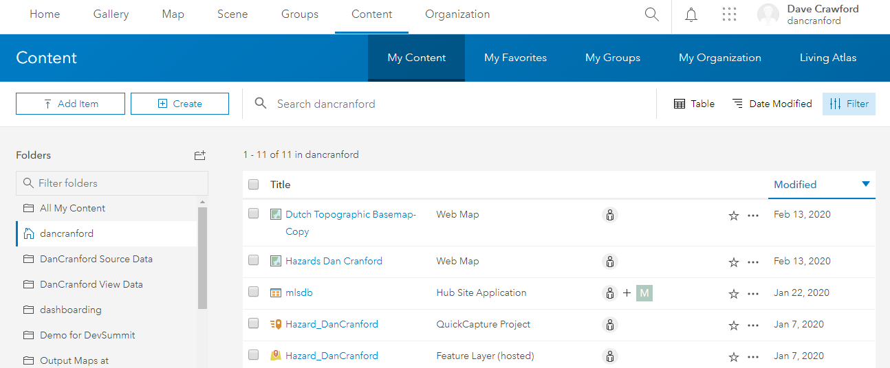
ArcGIS Online Basics

Slide 9
ArcGIS Online Basics
Items
Data
Feature Layers
Tile Layers
Web Maps
Web Mapping Applications
Dashboards
Users
Groups

